Slide 1

BTH645 - Multimedia Elements for User Interfaces
Shi, Yue (Sunny)
Office: DB2095
sunny.shi@senecacollege.ca
SENECA COLLEGE
Notes:
Good morning and welcome back. I hope you all had a great summer.
This photo is a rendering of our Peterborough Airport campus which is well under way for our January 2014 opening.
And the entire design and build process is exemplary of the entire college community coming together to create a great place for our students to study.

Slide 2
Outline
More on p5.js
Animation
Image Animation
Mouse operation
dom

Slide 3
Animation
To create an animation, use variables to control how something is drawn in each frame
function setup() – called once when the sketch first loaded
function draw() – called once every frame
frameRate(30);
Default: 60 fps (frames per sec)

Slide 4
Environment
createCanvas(600,400);
width/ height - (default: 100)
System variable, stores the width/height of the drawing canvas. This value is set by the first/second parameter of the createCanvas() function.
displayWidth/ displayHeight
System variable that stores the width/height of the entire screen display. This is used to run a full-screen program on any display size.

Slide 5
Environment
frameCount:
The system variable frameCount contains the number of frames that have been displayed since the program started. Inside setup() the value is 0, after the first iteration of draw it is 1, etc.
frameRate(val);
Specifies the number of frames to be displayed every second
The default rate is 60 frames per second. This is the same as setFrameRate(val).
Calling frameRate() with no arguments returns the current framerate. This is the same as getFrameRate().

Slide 6
Functions
function setup() contains all of the code we want to run when our canvas is initialized.
It sets key values such as canvas element's size and framerate.
function setup() { createCanvas(500, 250); background(245); frameRate(30); }

Slide 7
Functions
function draw() : most of your drawing should take place.
P5.js automatically loops the draw() function at the frameRate() you specify in your setup().

Slide 8
Functions
random():
Return a random floating-point number. Takes either 0, 1 or 2 arguments.
If no argument is given, returns a random number from 0 up to (but not including) 1.
If one argument is given and it is a number, returns a random number from 0 up to (but not including) the number.
If one argument is given and it is an array, returns a random element from that array.
If two arguments are given, returns a random number from the first argument up to (but not including) the second argument.

Slide 9
Transform
translate(x, y);
Specifies an amount to displace objects within the display window
Transformations are cumulative and apply to everything that happens after and subsequent calls to the function accumulates the effect.
For example, calling translate(50, 0) and then translate(20, 0) is the same as translate(70, 0).
If translate() is called within draw(), the transformation is reset when the loop begins again. This function can be further controlled by using push() and pop().
rotate(angle);
Rotates an object the amount specified by the angle parameter.
Angles should be specified in radians (0 to PI*2)

Slide 10
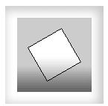
Transform
translate(width/2, height/2);
rotate(PI/3.0);
rect(-26, -26, 52, 52);

Slide 11
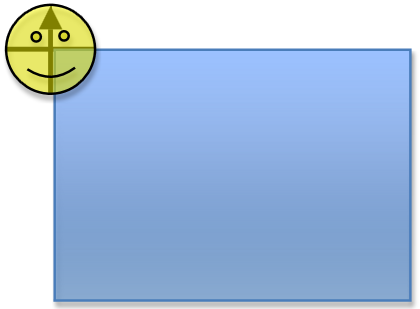
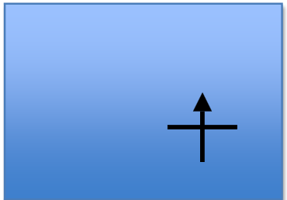
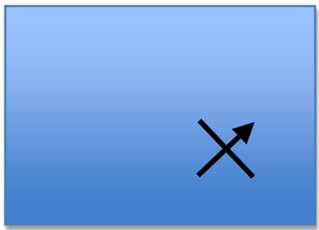
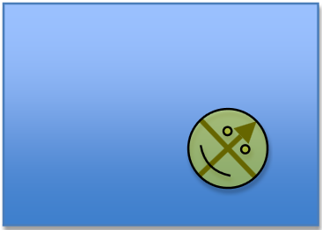
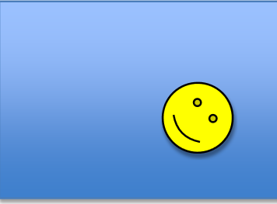

Slide 12
Examples
Moving triangle (frame based):
p5Animation.html
animation_triangles.js
animation_triangles_spin.js

Slide 13
Image Animation
preLoad the image(s)
function preload() {
img = loadImage('image/pic1.jpg');
}
Set frame Rate for animation:
frameRate(15);
Animation design
image(img, 0+pos,0+pos, 25, 25);
image_animation1.js

Slide 14
Image Animation
Generate random numbers
random(high)
random(low, high)
image(img, 0+random(10,500),0+ random(10, 500), 25, 25);
image_animation2.js

Slide 15
Image Animation
Animation image Sequence
hulaHoop.js
Reference: http://processingjs.org/learning/topic/sequential/

Slide 16
Image Animation
var numFrames = 8; // The number of frames in the animation
var frame = 0;
var images=[];
var img;
function preload(){
images[0] = loadImage("data/PT_anim0000.gif");
images[1] = loadImage("data/PT_anim0001.gif");
images[2] = loadImage("data/PT_anim0002.gif");
images[3] = loadImage("data/PT_anim0003.gif");
images[4] = loadImage("data/PT_anim0004.gif");
images[5] = loadImage("data/PT_anim0005.gif");
images[6] = loadImage("data/PT_anim0006.gif");
images[7] = loadImage("data/PT_anim0007.gif");
}
int numFrames = 12;
// The number of frames in the animation

Slide 17
Image Animation
function setup()
{
createCanvas(200, 200);
background(222);
frameRate(10);
}
function draw()
{
frame = (frame+1)%numFrames; // Use % to cycle through frames
image(images[frame], 0, 0, 200, 200);
//image(img,0,0,200,200);
}

Slide 18
Mouse
System variables:
mouseButton:
Values: LEFT, RIGHT, CENTER
which button is pressed.
if (mousePressed && (mouseButton == LEFT)) {..}
mouseX:
Current X-coordinate of mouse
mouseY:
Current X-coordinate of mouse
mousePressed:
true/false
function draw()
{
if (mousePressed == true)
{
fill(0);
} else {
fill(255);
}
rect(25, 25, 50, 50);
}

Slide 19
Mouse
Functions:
called when the corresponding mouse events occur
mouseClicked()
mouseMoved()
mouseDragged()
mouseOut()
mouseOver()
mousePressed()
mouseReleased()

Slide 20
Mouse - examples
mouseClicked.js
mousePressed.js
mouseMove.js

Slide 21
DOM
<script src = "../addons/p5.dom.js"> </script>
<script src = "https://cdnjs.cloudflare.com/ajax/libs/p5.js/0.6.0/addons/p5.dom.js"> </script>
dom_parent.js
dom_createImage.js
dom_createElement.js
Reference: https://github.com/processing/p5.js/wiki/Beyond-the-canvas

Slide 22
A3

Slide 23
References
https://p5js.org/reference/
https://p5js.org/reference/#/libraries/p5.dom

Slide 24
Thank you!

